Slide 1
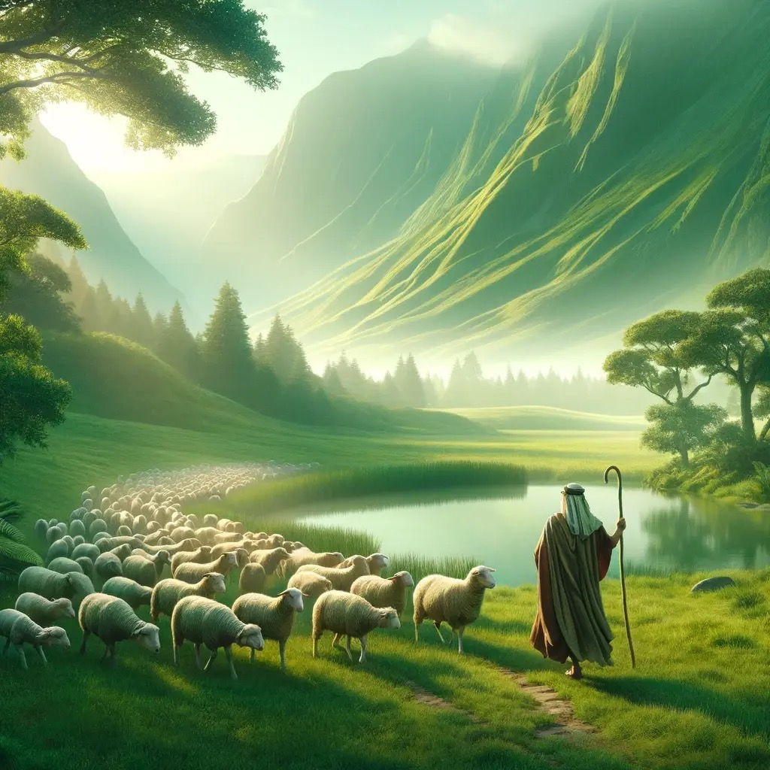
耶和华是我的牧者
The Lord is My Shepherd

Slide 2

耶和华是我的牧者, 我必不致缺乏
祂使我躺卧在青草地上,
领我在可安歇的水边.
The Lord is my shepherd, I lack nothing.
He makes me lie down in green pastures, He leads me beside quiet waters

Slide 3
祂使我的灵魂苏醒,
为自己的名引导我走义路.
我虽然行过死荫的幽谷,也不必怕遭害
He refreshes my soul. He guides me along the right paths for his name’s sake. Even though I walk through the darkest valley, I will fear no evil

Slide 4
因为你与我同在,
你的杖 你的竿都安慰我.
因为你与我同在
在我敌人面前,你为我摆设筵席
For You are with me; Your rod and Your staff,
they comfort me. You prepare a table before me
in the presence of my enemies.

Slide 5
你用油膏了我的头,使我的福杯满溢
你用油膏(我的头x2), 我(福杯满溢x2)
我一生一世 必有恩惠慈爱随着我,
我要住在耶和华的殿中.
You anoint my head with oil; my cup overflows.
Surely your goodness and love will follow me all the days of my life, and I will dwell in the house of the Lord

Slide 6
耶和华是我的牧者, 我必不致缺乏
祂使我躺卧在青草地上,
领我在可安歇的水边.
The Lord is my shepherd, I lack nothing.
He makes me lie down in green pastures, He leads me beside quiet waters

Slide 7
祂使我的灵魂苏醒,
为自己的名引导我走义路.
我虽然行过死荫的幽谷,也不必怕遭害
He refreshes my soul. He guides me along the right paths for his name’s sake. Even though I walk through the darkest valley, I will fear no evil

Slide 8
因为你与我同在, 你的杖
你的竿都安慰我. 因为你与我同在
在我敌人面前,你为我摆设筵席
For You are with me; Your rod and Your staff,
they comfort me. You prepare a table before me
in the presence of my enemies.

Slide 9
你用油膏了我的头,使我的福杯满溢
你用油膏(我的头x2), 我(福杯满溢x2)
我一生一世 必有恩惠慈爱随着我,
我要住在耶和华的殿中.
You anoint my head with oil; my cup overflows.
Surely your goodness and love will follow me all the days of my life, and I will dwell in the house of the Lord

Slide 10

耶和华的殿, 直到永远.
in the house of the Lord, forever.

